Slide 1
GH Archive Data Analysis
Analyzed the type of events that happened on 13th July 2020
Analyzed the number of issues that were created
Analyzed the average number of issues that were opened or closed on this day.
By: Vithika Agrawal

Slide 2
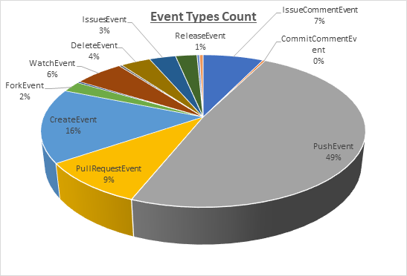
Analyzed the Type of Events executed
On 13th July 2020, i.e. on a Monday, most of the users have pushed their data into the repositories.
Insight:
This day’s activity suggest that 49% of users were engaged in pushing their data into their repositories, followed by 16% of users creating new repositories.

Slide 3
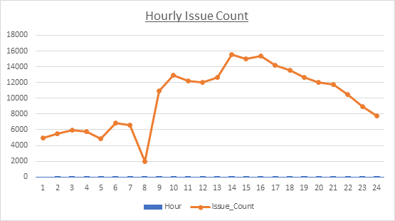
Analyzed the number of issues raised per hour
Insight: This trend suggests that most people raise their issues during their official working hours
On Monday, most of the issues that were raised in Github were in between 9:00AM - 6:00PM with maximum issues raised at 2:00PM

Slide 4
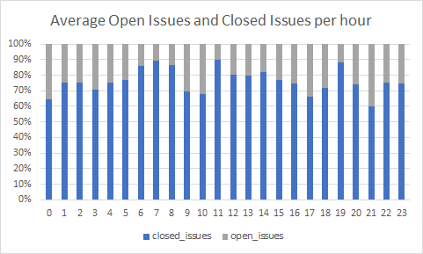
Analyzed the Open/ Closed Issues per hour
At 11:00 AM, 90% of issues that were created by the users were closed.
Insight:
This graph suggests that , on an average, more than 60% of the issues that were raised were resolved within a day’s time.

